Slide 1
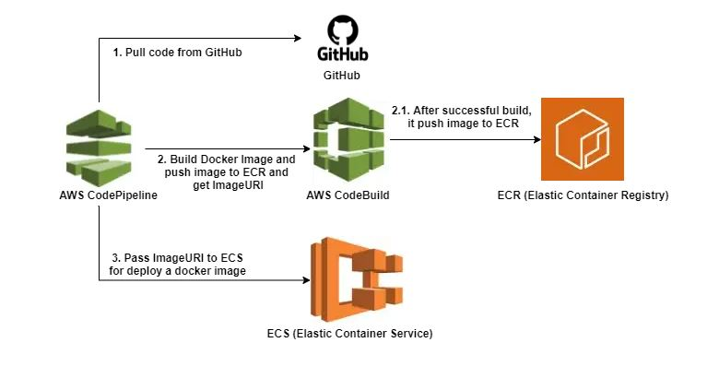
Pokémon CI/CD Architecture

